Slide 1
USA Staffing Applicant Documentation Command Brief
Recruitment Tools And Processes Division
Office of Civilian Human Resources
May 2018

Slide 2
BLUF
28 May 2018, all documentation that supports applicant eligibility and qualifications will be required at the time of application
Eligibility will be determined PRIOR to referral to the hiring manager
Applicants who do not provide supporting documentation, or provide documentation that does not support their claims, will not be referred

Slide 3
Agenda
Reason for the change
Applicant certification
Current DON applicant documentation process
New DON applicant documentation process
Instructions for submitting documentation
Review

Slide 4
Reason for the Change
This change was a result of customer input and is expected to:
Increase the quality of our certificates
Standardize application procedures for all DON vacancy announcements
Align DON with the application processes of other DoD and Federal agencies
Reduce the wait time for tentative job offers

Slide 5
Applicant Certification
Applicants to DON Job Opportunity Announcements must answer questions to make claims regarding their eligibility and qualifications
Applicant answers or “claims” must be verified by an HR Specialist before certification and referral to the hiring manager
Verification requires review of eligibility and qualifications documentation

Slide 6
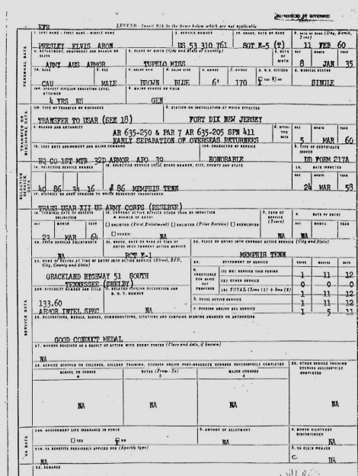
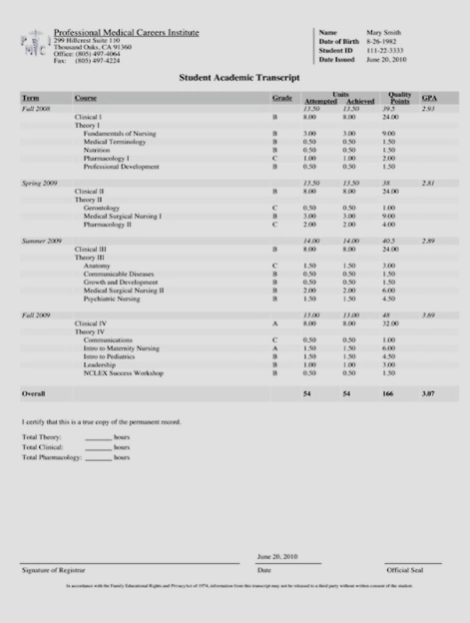
Current Documentation Process
On internal recruitments, i.e. status candidates, the HR Specialist uses the content of the resume to verify applicant claims
On external recruitments, i.e. public candidates, the HR Specialist requires supporting documentation (e.g. DD-214, Transcripts, etc.) to verify applicant claims

Slide 7
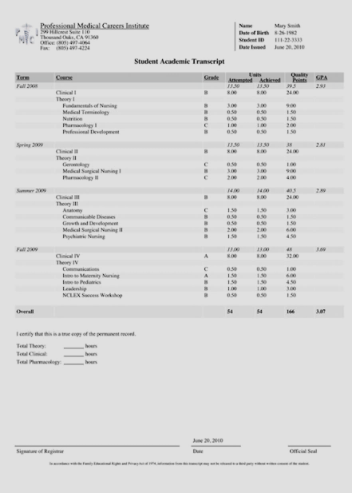
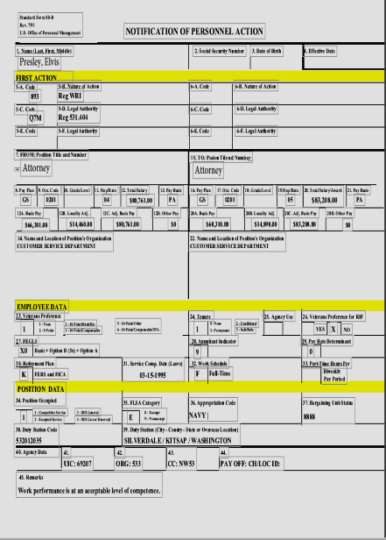
New Documentation Process
Internal and external recruitments will have the same process
Status candidates (including DON employees) must submit supporting documentation (e.g. SF-50, Transcripts, etc.) to support the claims made in the application

Slide 8
DON employees need to know
All DON announcements will identify the required documents
If required by the position, unofficial transcripts should be submitted at time of application. Unofficial transcripts are free and can be printed from the student portal of the college website. If you encounter difficulty using the school’s student portal, call the school’s registrar office
SF-50s can be downloaded from DCPDS MyBiz+ or eOPF
Documents loaded to USAJOBS once can be re-used
HR Specialists at the OCHR Operations Centers will not change an applicant's answer to a question, even upon request
OCHR Operations Centers will not accept documents after the closing date of the announcement unless USAJOBS or USA Staffing acknowledges the system was at fault
It is the responsibility of the applicant to make sure the documents submitted are the correct documents

Slide 9
Documentation Requirements
Announcement Text
Application
General documentation requirements are located in the Required Documents section of the Announcement Text
Specific documentation requirements are listed for each eligibility in the Eligibilities section of the Application.

Slide 10
Required Documents
Not all required documents will be marked required. Only documents required of all applicants are marked required. Document requirements that vary by type of applicant (i.e., DD-214 or SF-50) will not say required, but you must submit the document that applies to you.

Slide 11
Submitting Documents
Click the dropdown box next to every accepted document type that applies to you and select your document to submit it. Documents not assigned to an accepted document type will NOT be submitted with the application

Slide 12
Adding New Documents
If you are missing a required document in the drop down, you can upload it at the bottom of the page and it is immediately available in the dropdown.

Slide 13
Unassigned Documents
If there are any documents in your account that were not assigned to an accepted document type, you will get a pop up warning. Review carefully! The documents listed in the pop up will NOT be submitted as part of your application.

Slide 14
Missing Required Documents
If you do not submit a document marked required, you will not be able to submit your application

Slide 15
Missing Required Documents
You must have all green check marks to apply

Slide 16
Review
Change takes effect 28 May 2018
All applicants must provide eligibility and qualification documentation at the time of application
Eligibility and qualifications determinations will be made prior to referral to the hiring manager
Applicants who do not provide supporting documentation, or provide documentation that does not support their claims, will not be referred

Slide 17
Questions
USA Staffing dawn.fish@navy.mil

